Slide 1

TechX Consulting
Methodology Analysis
Company: Organization Z
Project: Enterprise Resource Planning (ERP)
Prepared by: Katharine Harshman
December 2024

Slide 2


Scenario
Enterprise Resource Planning Implementation
Objective: Implement the ERP system within 6 months, with minimal disruption to current operations
Team Composition: Project managers, IT staff, software vendors, external consultants, and three department heads
Budget: $1,500,000
Success Metrics: On-time system implementation with minimal disruption, appropriate training of staff on the new ERP system, and successful performance of new system within 6 months of launch.

Slide 3

Project Methodologies
Overview
Standardized project management methodologies provide structured approaches to manage projects efficiently.
Two widely recognized methodologies are Waterfall and Agile.
2

Slide 4

Waterfall
Project Methodologies Overview
Waterfall is a linear and sequential methodology, progressing through defined phases: initiation, planning, execution, monitoring, and closing.
It involves extensive documentation, including project charters, Gantt charts, and detailed requirements, ensuring that all stakeholders have a clear understanding of the project scope and timeline from the beginning.
The project manager plays a central role in planning, execution, and stakeholder communication.

Slide 5

Agile
Project Methodologies Overview
Agile, in contrast, emphasizes flexibility and iterative progress. Work is divided into short cycles called sprints, enabling teams to adapt to changes and continuously deliver value.
Documentation is lightweight and updated throughout the project. A Scrum Master facilitates the process by removing barriers, while the team collaboratively manages deliverables and adjusts priorities based on feedback.

Slide 6



Benefits
Project Methodologies Overview
1
Consistency: Defined roles, processes, and documentation ensure uniformity in managing projects.
2
Improved Communication: Stakeholders are aligned with the project’s progress through standardized reporting.
3
Predictability: Clear milestones and structured workflows improve the ability to anticipate and manage risks.
3

Slide 7

Selection: Waterfall
Project Methodologies Overview
For Organization Z’s Enterprise Resource Planning (ERP) project, the Waterfall methodology is the best fit.
Its structured phases ensure thorough planning and coordination among diverse stakeholders, critical for integrating an ERP system.
Additionally, Waterfall’s emphasis on documentation will ensure minimal disruption and alignment with Organization Z’s need for a timely and predictable implementation.

Slide 8




PROJECT TIMELINE
MILESTONES
January 15
February 28
Completion of the initiation phase, with approved objectives, scope, and budget.
Completion of the planning phase, with a detailed project plan ready for execution.
May 15
June 30
Completion of ERP system implementation, including customization and initial testing.
Successful project closure, including staff training and final system sign-off.

Slide 9
PROJECT TIMELINE
JAN
FEB
MAR
APR
MAY
JUN
INITIATION
Define objectives, scope, and deliverables.
Identify stakeholders and assign roles.
Establish a budget, timeline, and approval processes.
PLANNING (6 weeks)
Develop a detailed project plan, allocate resources and define schedules.
Perform risk assessments,coordinate vendors.
Finalize all documentation and obtain stakeholder approval to proceed.
EXECUTION (10 weeks)
Implement the ERP system in stages, setup hardware and integrate software.
Customize the system and migrate existing data.
Perform initial system testing to identify and resolve technical issues.
MONITORING & CONTROLLING (Ongoing thru planning & execution)
Track progress against the project plan.
Address deviations and adjust schedules as necessary.
Conduct status meetings to keep stakeholders informed.
CLOSING
Conduct final testing for reliability.
Obtain stakeholder sign-off.
Finalize project documentation.
Deliver staff training and launch.
Enterprise Resource Planning Implementation

Slide 10

Potential Challenges
Enterprise Resource Planning Implementation
Stakeholder Misalignment: Conflicts between department heads may delay decisions.
Waterfall’s documentation and phase approvals will help clarify roles and responsibilities.
Integration Issues: Compatibility problems with existing systems could arise.
Waterfall’s planning phase includes rigorous requirements gathering and testing plans to address such risks.

Slide 11
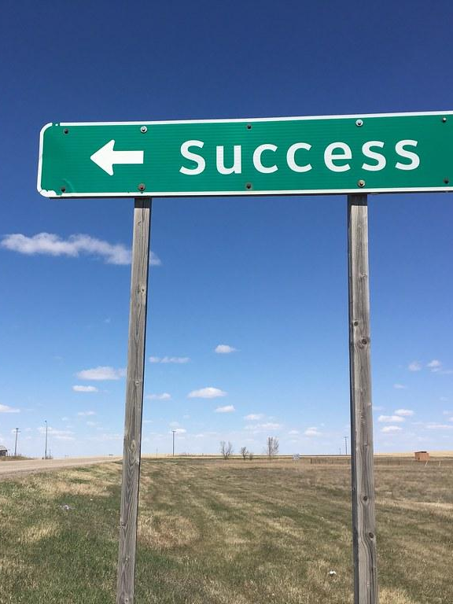
Success Metrics
Enterprise Resource Planning Implementation
Waterfall is the ideal methodology for meeting the success metrics of this ERP implementation project because of its structured and predictable nature. By emphasizing detailed upfront planning and continuous monitoring, Waterfall ensures the project remains on schedule and within budget, which are critical priorities for Organization Z.
Additionally, the method’s focus on a well-defined closing phase includes comprehensive staff training, equipping employees to use the new ERP system effectively from day one.
Finally, rigorous testing during the execution phase guarantees that the system is reliable and fully operational within six months of launch, minimizing disruptions and ensuring a smooth transition.
This disciplined approach aligns perfectly with the project's objectives and success criteria.

Slide 12

References
Biafore, B. (2022). The waterfall project management lifecycle [Video]. LinkedIn Learning. Retrieved December 24, 2024, from https://www.linkedin.com/learning/
Clayton, M. (2022). What is Waterfall Project Management? [Video]. Online PM Courses. Retrieved December 24, 2024, from https://www.youtube.com/watch?v=d9Tecl1WZBk
Coursera. (n.d.). Adopting an agile mindset and understanding VUCA [Video]. Retrieved December 24, 2024, from https://www.coursera.org/videos/agile-project-management/Kt3Hu
Le, N. (2023, July 2). Comparing Waterfall and Agile approaches. LinkedIn Learning. Retrieved December 24, 2024, from https://www.linkedin.com/learning/
Watt, A. (2014). Project management (2nd ed.). BCcampus. Victoria, B.C. Retrieved December 24, 2024, from https://opentextbc.ca/projectmanagement/

